Slide 1
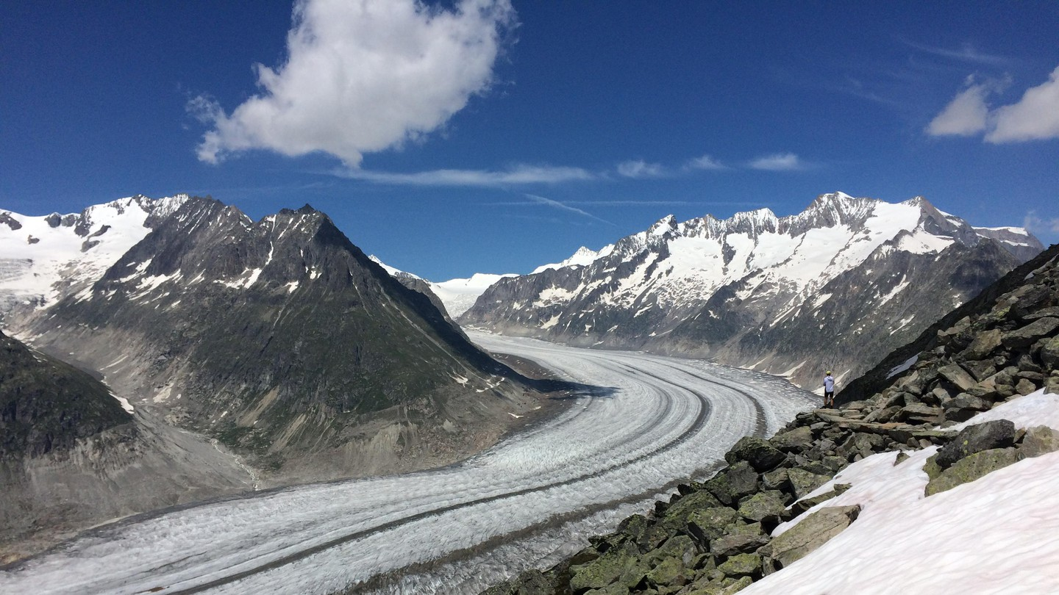
Field work
25-08-2025

Slide 2
Practical points – by evening, tomorrow, 26.08, to Carey:
Group’s destination
Date of birth
If you have a reduction card for the Swiss trains

Slide 3
Other practical points
Hiking maps: https://map.geo.admin.ch
Template for the evaluation
Sun cream and rain cover (you never know)

Slide 4
1. Aletsch:Marjelenseen

Slide 5
Marjelenseen

Slide 6
2. Saas Fee: Gletschersee

Slide 7
Gletschersee

Slide 8
3. Zermatt: Zmutt glacier

Slide 9
Zmutt glacier

Slide 10
Zmutt glacier

Slide 11
Randa: in your way to Zermatt

Slide 12
Bonne promenade!

Slide 13
Field trip groups
Aletsch | Saas Fee | Zermatt
Marc Grädel | Rim Nabha | André Hansen Vieira
Ocson Reginald Cocen | Nour Nasser | Mario Gualavisí
Léa de March | Meriam Dhieb | Khalef Boulefrakh
Thanmaya Arunkumar | Kevin Huynen Ciolak | Hassan Jamil
Shungui Deng | Alejandro Velázquez | Arianna Passaretti
 | Naoufal Mekouar

